Slide 1
TravelMinds Gen AI Project
Team 2: Derleen Saini, Mike Quach, Soumya Mohan, Ryan Schmitzer
Notes:
Business problem statement
Architecture diagram (does it make sense)
Have code working

Slide 2
Table of contents
01
02
03
04
05
06
Introduction
Business Problem and Solution
Architecture
What is TravelMinds?
Gen AI model
What problem are we solving
Improvements
Conclusion and Q&A
Data/ Product Demo
Overview and future potential

Slide 3
01
Introduction
Notes:
Sources:
https://www.trade.gov/travel-tourism-industry
https://www.statista.com/statistics/1099933/travel-and-tourism-share-of-gdp/#:~:text=Overall%2C%20these%20industries%20represented%207.6,to%207.7%20trillion%20U.S.%20dollars.
https://www.mckinsey.com/industries/travel-logistics-and-infrastructure/our-insights/future-of-tourism-bridging-the-labor-gap-enhancing-customer-experience

Slide 4
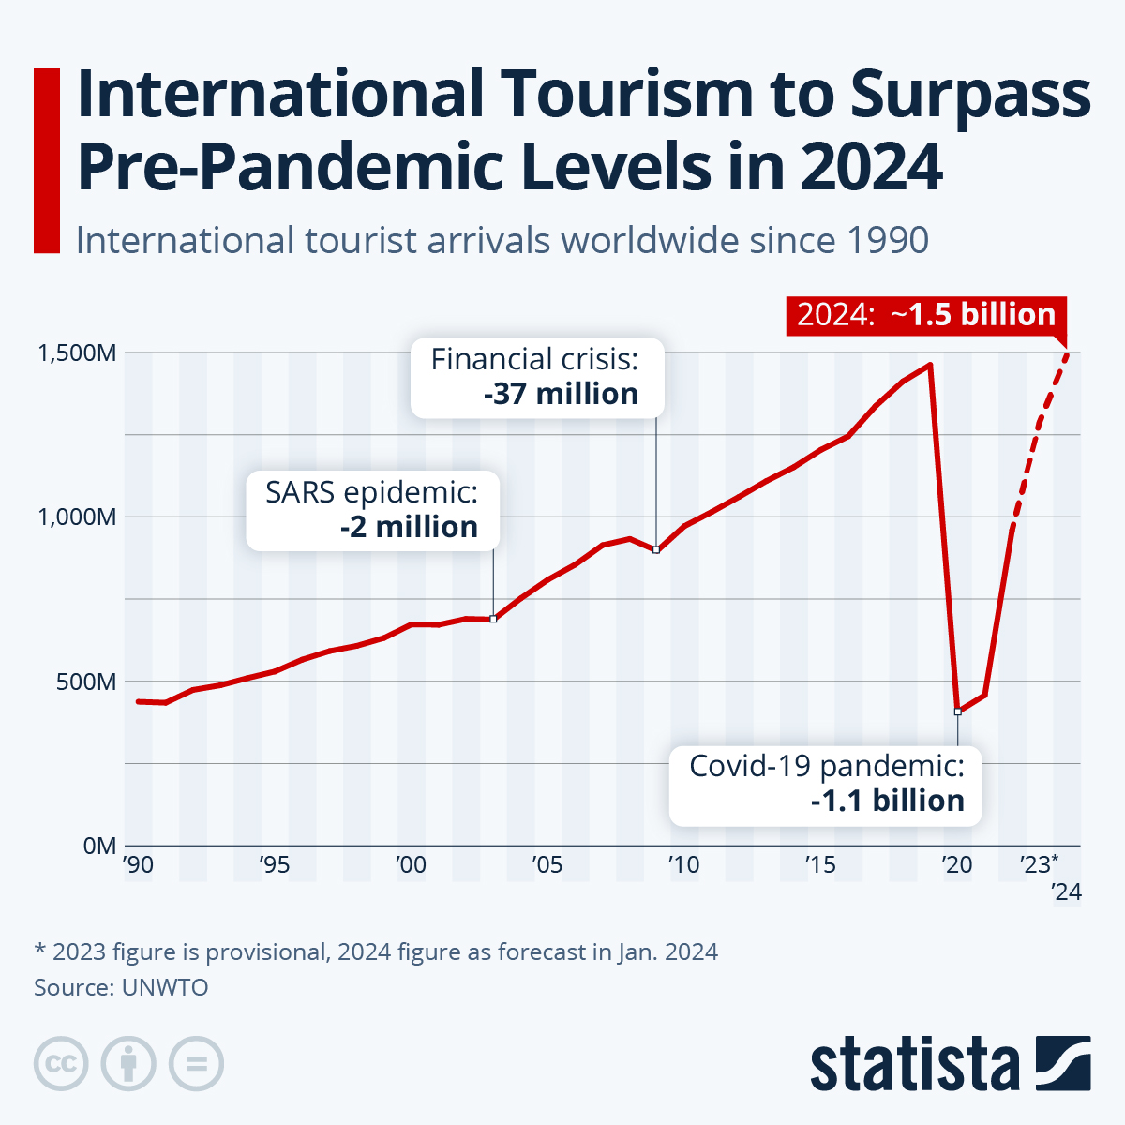
Introduction
9.6% of Global GDP
Global Travel ~2 trillion market
52% of Americans are putting aside $4,000+
5.8% annual growth
Notes:
.The travel industry is a trillion-dollar sector, accounting for nearly 11.6% of global GDP. In 2023, it saw a resurgence with international air travel growing by over 52% compared to 2022. Forecasts indicate continued growth, with the global travel market expected to reach $2 trillion by 2025. The industry's rebound is fueled by factors such as easing pandemic restrictions, rising disposable incomes, and an increase in sustainable travel options, contributing to its projected annual growth rate of 5-6% over the next few years.

Slide 5
02
Business Problem and Proposed Solution
Notes:
Sources:
https://www.trade.gov/travel-tourism-industry
https://www.statista.com/statistics/1099933/travel-and-tourism-share-of-gdp/#:~:text=Overall%2C%20these%20industries%20represented%207.6,to%207.7%20trillion%20U.S.%20dollars.
https://www.mckinsey.com/industries/travel-logistics-and-infrastructure/our-insights/future-of-tourism-bridging-the-labor-gap-enhancing-customer-experience

Slide 6

Business Problem
Issue:
Inefficient travel planning
Time Consuming
20 - 30 hrs
Cost
Planning itineraries around the shortlisted attractions
Notes:
Issue:
Many travelers struggle to plan their trips efficiently, especially when visiting a new destination.
They often face challenges in finding attractions that align with their interests and preferences, leading to suboptimal travel experiences.
Impact:
Without personalized travel planning solutions, travelers may miss out on must-see attractions or waste time and money on activities that do not match their interests.
This can result in frustration, decreased satisfaction with the trip, and potential negative reviews or word-of-mouth feedback.
Impact:
Miss out on must-see attractions
Waste time and money on activities that do not match their interests
Frustration, decreased satisfaction and negative reviews

Slide 7

Solution
Opportunity
Leverage Generative AI
Increase efficiency
Customization
Proposed Solution
Match user interests with relevant attractions
Improves the travel experience
Notes:
Opportunity
There is a significant opportunity to address this pain point by providing a solution that leverages advanced technologies such as cosine similarity and language models to deliver personalized travel itineraries.
By offering tailored recommendations based on user input and preferences, businesses can enhance the overall travel experience and differentiate themselves in a crowded market.
Proposed Solution
Our travel itinerary generator addresses this business problem by utilizing cosine similarity to match user interests with relevant attractions and leveraging language models to generate customized itineraries.
By providing personalized recommendations, we empower travelers to make the most of their trips, resulting in increased satisfaction and positive reviews.
By solving the problem of lack of personalized travel planning solutions, our product not only improves the travel experience for users but also enhances brand loyalty, drives customer engagement, and increases revenue opportunities for travel businesses.

Slide 8
03
Architecture

Slide 9
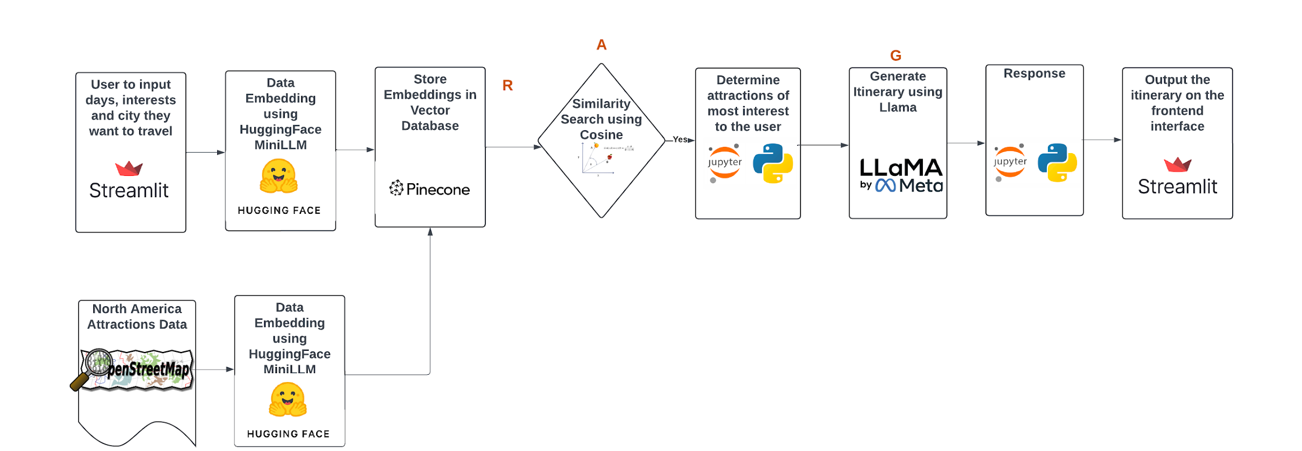
Architecture

Slide 10
Architecture

Slide 11
Architecture

Slide 12
04
Backend & Data

Slide 13
Data
Source: Open Street Map
59
Attraction Type
6808
Locations
3286
cities

Slide 14
Embedding
Embedding:
Method to represent words or phrases as vectors for language processing tasks.
Embed locations with cities as filters
Embed user inputs include city, interest and trip duration.
Model:
Hugging Face’s Sentence Transformer
384 Dimensions
Pinecone:
Online vector database to store and allow for similarity search

Slide 15
Semantic Search
Calculate
Filter
Input
Results
Cosine distance with output
By cities
Top 6

Slide 16
04
Product Demo

Slide 17
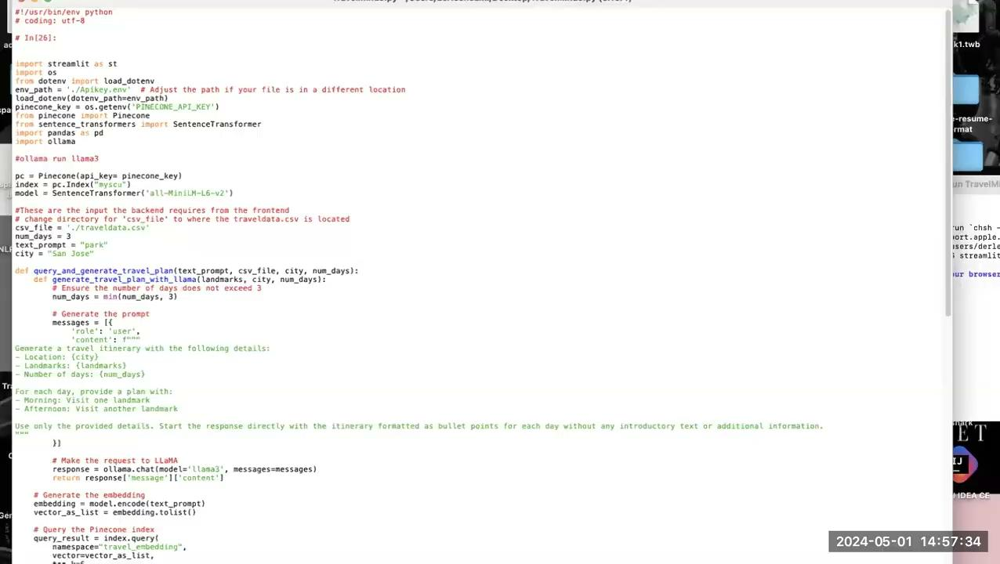
Product Demo

Slide 18
05
Improvements

Slide 19

Future Improvements
Contextual Recommendations:
Time of day, weather, location, and group size, budget
Enhance suitability and practicality
Future Integrations:
Weather API
Google Maps - routes, roads, maps
Currency Exchange
Travel API’s - Kayak, Expedia, Yelp
Adaptive Learning: The AI can adapt to market trends over time, ensuring its suggestions remain relevant and up-to-date.
Notes:
budget, group size, time of day, start and end date, other box Weather, google map api, travel apis like expedia and yelp, currency exchange

Slide 20
06
Conclusion

Slide 21
Conclusion
Personalized Suggestions:
Analyze user preferences (User Input)- generate tailored activities
Improve user satisfaction and engagement
Variety:
Broad range of activities offered
Help users explore and discover interests
Time Efficiency:
Can quickly generate activity suggestions based on various inputs
Saves time spent researching or planning
Notes:
Personalized Suggestions: The application can analyze user preferences and past behaviors to generate tailored activities, improving user satisfaction and engagement.
Variety: By offering a broad range of activities, including new or lesser-known options, the application can help users explore and discover interests they might not have otherwise considered.
Time Efficiency: The AI can quickly generate activity suggestions based on various inputs, saving users time spent researching or planning.

Slide 22
Thank You!
Any Questions?

Slide 23
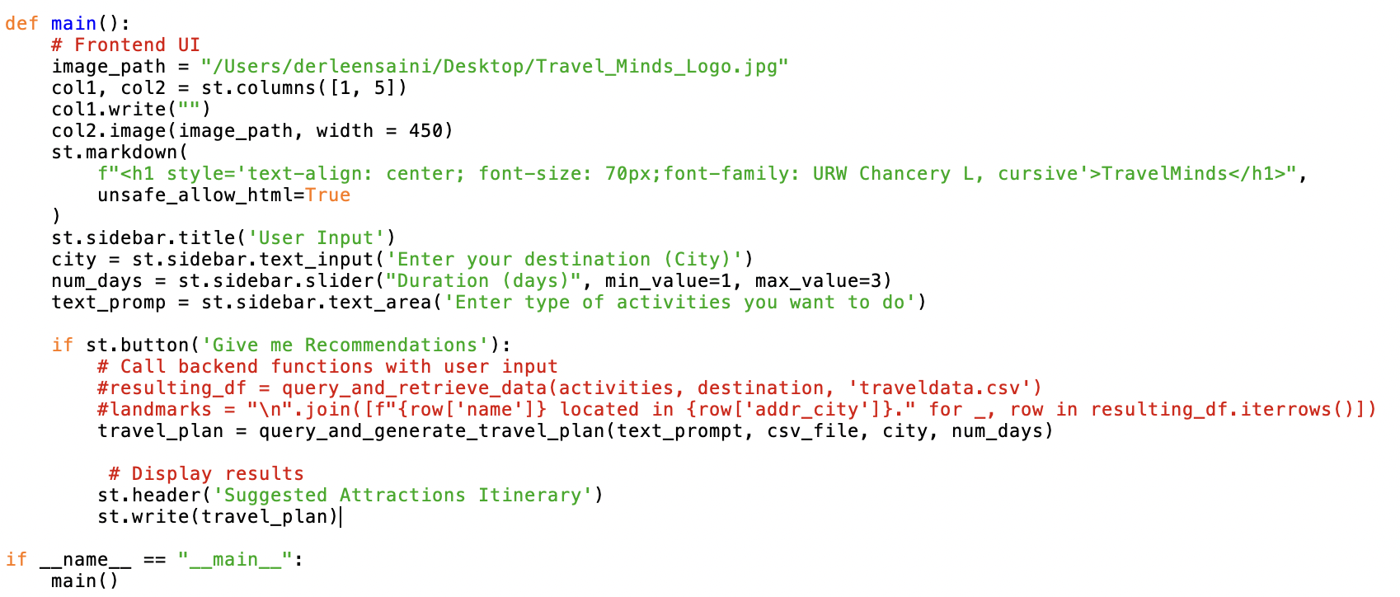
Streamlit

Slide 24
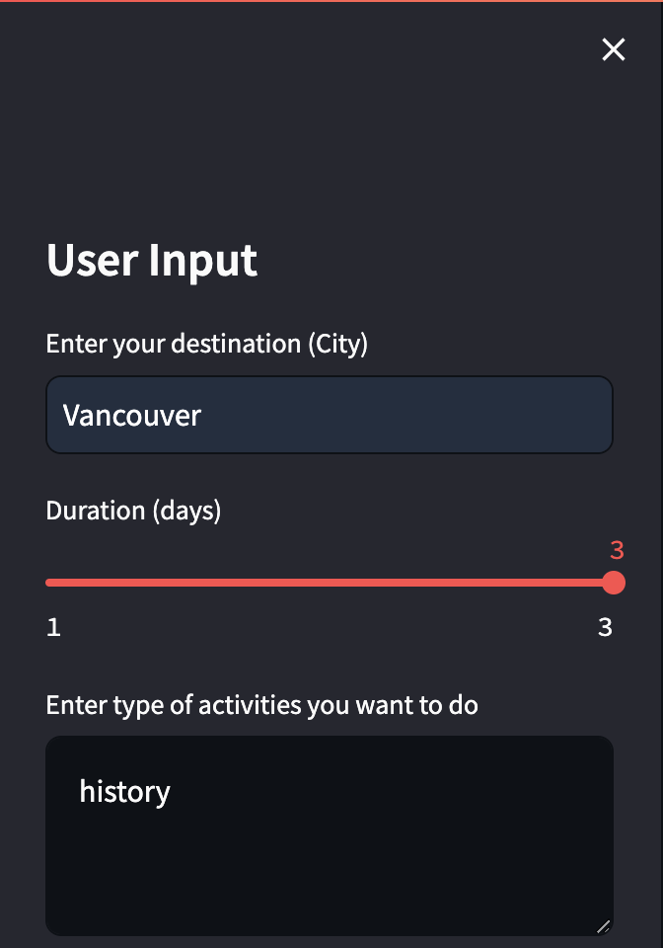
Product Demo

Slide 25
